Slide 1
Database Design and Performance Test
Ziyu Wang
He Wang

Slide 2
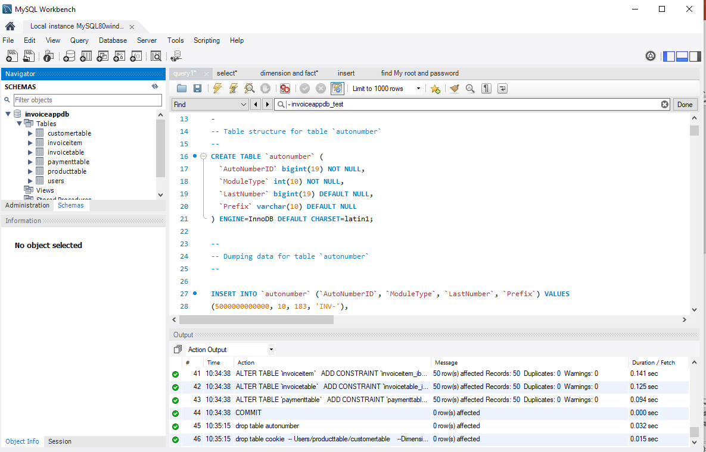
Create a database
Notes:
I create a dataset named ‘invoiceappdb’ I have 6 tables in the database.

Slide 3
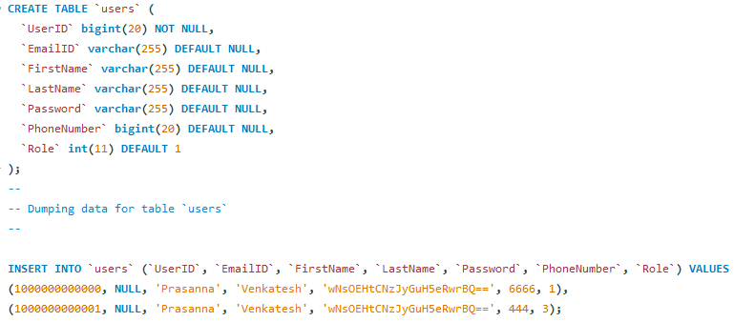
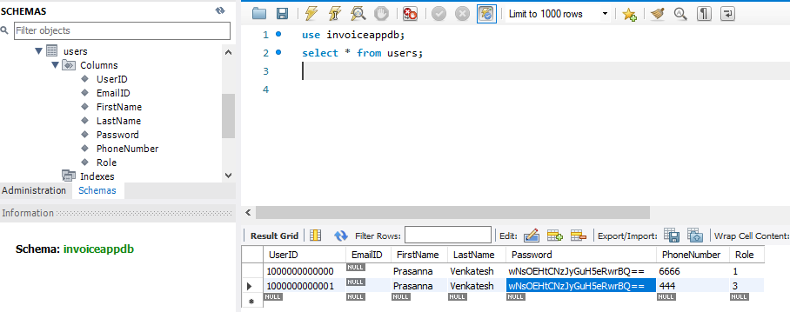
User table
Notes:
user table: For example, I am the owner of this supermarket, After you purchase my products, I will give you an invoice (bill), only I can bill you, so I am the owner of this invoice, I am the person who writes the bill. However, only those who meet the conditions in the user table can make a bill, if anyone can make a bill, the supermarket will be chaotic. Therefore, we specify in the user table: you must meet the criteria entered in the database, UserID, EmailID, Name, Password, PhoneNumber, Role you can open this invoice bill.

Slide 4
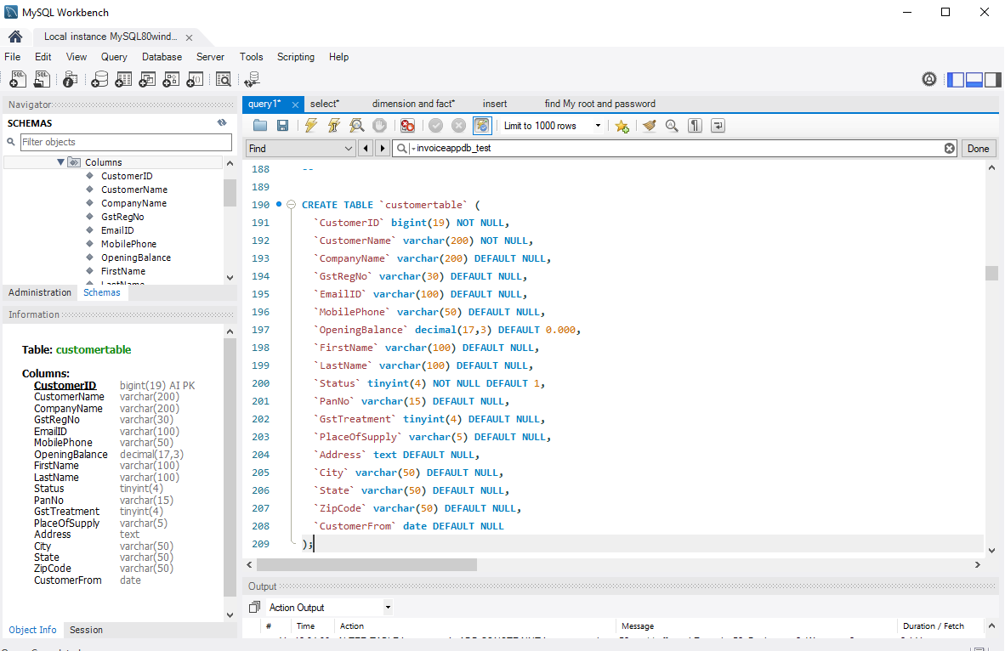
CustomerTable
Notes:
These are the columns in the customer table.

Slide 5
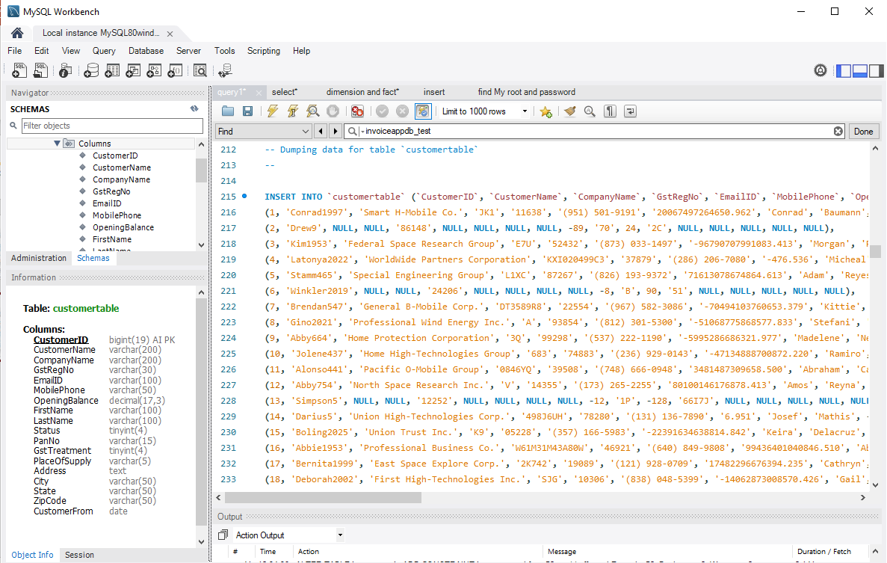
Insert Records into Customer Table
Notes:
I insert records using generatedata.com, and it automatically generate data, and then I put these data into each column.
And then I used the same method for other tables

Slide 6
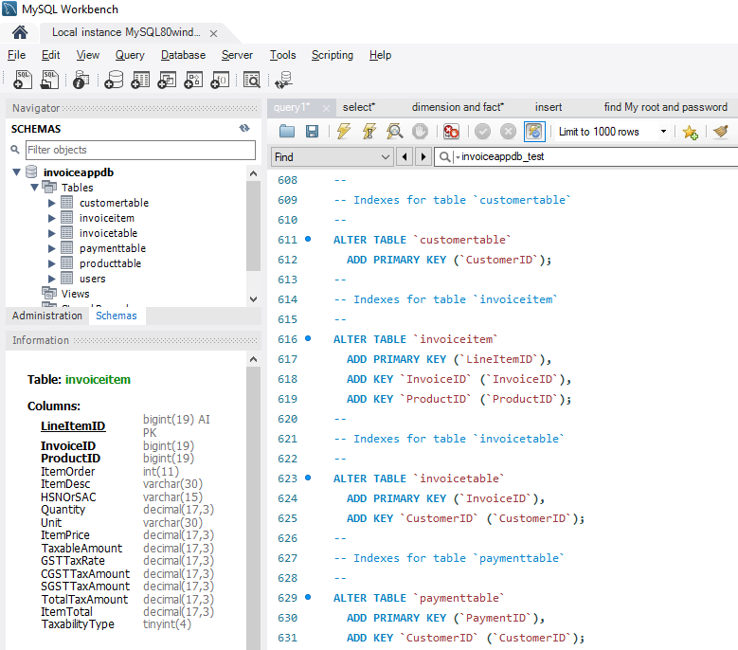
Add Primary Key (=Index) to each table
Notes:
And then I will add primary key ,which is index to each table.
Customer ID is the customer table’s primary key
ADD KEY: means we are telling the database these columns are the key columns. ‘Invoice ID’, ‘ProductID’, ‘LineItemID’ are the key columns. They can be primary key, they can be foreign key, they can be compound key, Composite key, Surrogate key, and other kinds of key.

Slide 7
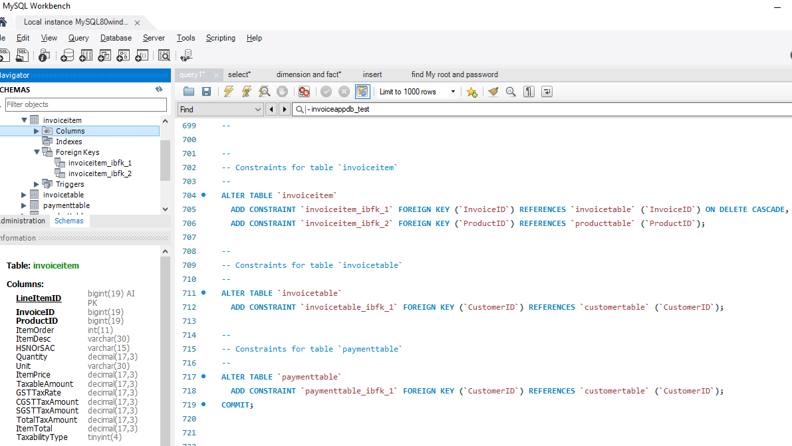
Add constraints for tables
Notes:
1. Constraint is the foreign key. All the keys are constraints. Here add constraint is add foreign key.
2. As you can see, in the ‘invoice item’ table, I create a foreign key ‘ invoiceitem_ibfk_1’ for the table ‘invoice item’.
3. The key ‘ invoiceitem_ibfk_1’ is in the column ‘Invoice ID’.
InvoiceID is the primary key for the invoicetable.
4. The ‘InvoiceID’ is the foreign key for the Invoiceitem table and invoiceID will be used by the ‘invoice item’ table to connect or reference to the invoice table. Because Invoice ID is the primary key for the invoice table and the foreign key for the invoice item table.
5. Reference means the invoiceID is the reference word, from this word, we come to invoicetable.
6. Foreign key means the invoiceID is the foreign key for the invoiceitem_ibfk_1.
7. Invoiceitem_ibfk_1 is the foreign key for the invoiceitem table.
8. DELETE CASCADE: means if you delete the table from the database, the table will be deleted, constraint will not be deleted, unless you delete the record of the table. If I don’t write DELETE CASCADE, then when I delete a table, everything in this table is deleted. For example, you create a table named invoice, you create a table named invoiceitem, and then you also create a link between these two tables. After a few moments, you feel that I have to delete invoiceitem table, the table will be removed from the database , but the constraint (=foreign key = link ) still remain in the database.

Slide 8
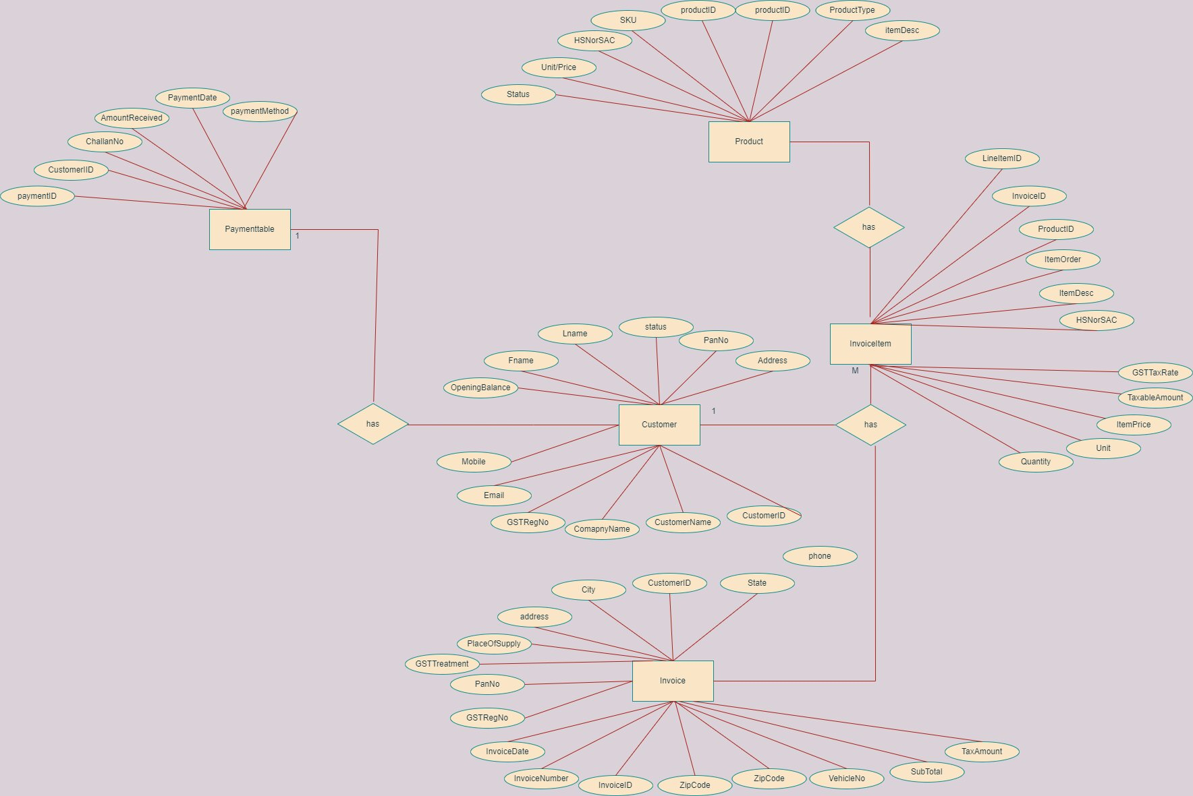
ER Diagram
Notes:
invoice ID in the invoice item is the foreign key, that foreign key is existing in invoice table as a primary key.
The relationship between our invoice table and invoice item table is one to many, so the invoice table and invoice item table cannot be merged into one table.
what is the relationship between Customer table and Product table? No relationship. but you could say customer buy product, but in this database, they don't have relationship, one customer can buy one product, so it is one to one. In another case, One customer can buy many products, so it is one to many. In the third case, many products can be bought by many customers, so it is many to many.
The relationship between customer and payment is one to many, a customer can have more than one payment, the same person can enter the supermarket twice to buy goods and thus get two payment bills. We have only one user in our dataset, single user, so we don't need to connect it with other tables. customer cannot generate invoice . in the invoice, we have the cutomer ID, which is used to connect the customer.

Slide 9
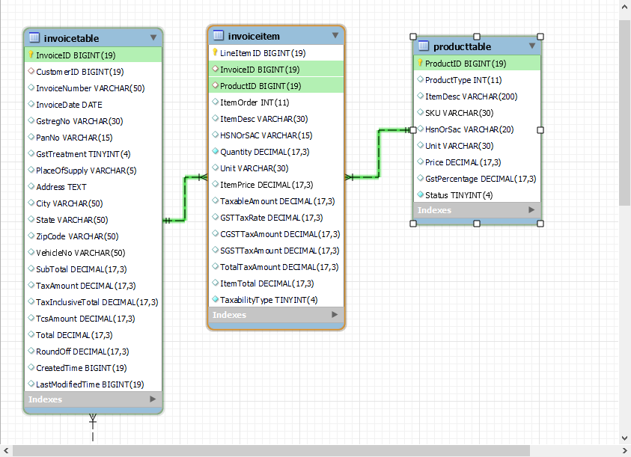
ER diagram
Notes:
Due to space limitations, I've split a diagram into two PPTs, but you'll see the full one when you combine them. Or you can see it in mysql workbench database reverse engineer part.
The relationship between our invoice table and invoice item table is one to many, so the invoice table and invoice item table cannot be merged into one table.
Why is that there is an invoice table and there is still an invoiceItem table? For example, a customer in the customer table goes to the supermarket to buy something, he buys 5 things, these 5 things are put into the Product Table, so from the figure you can see that the relationship between the customer table and the product table is one to many relationship. But when the owner (user table) generate the invoice, he will give you a single invoice (there are 5 products on this bill), but at this point, there is no need for the user table and invoice table to have a relationship, because it is meaningless and not reflected in the code, we do not need to know the relationship between the owner and the product, which is known to all, the store owner billing, the relationship is self-evident. You just need to know that User gives you a single invoice, and there are 5 items in this single invoice, so the relationship between our invoice table and invoice item table is one to many, so invoice table and invoice item table cannot be merged into one table.

Slide 10
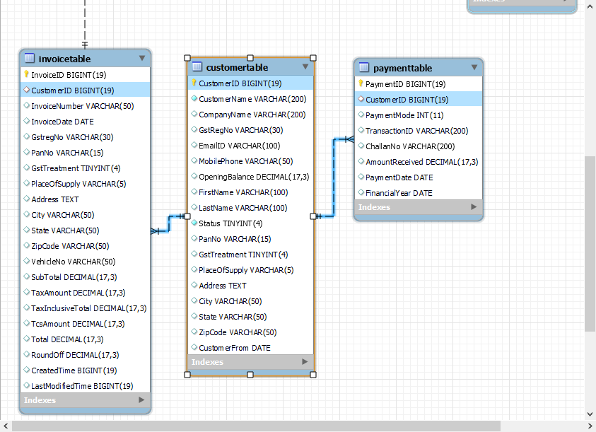
ER diagram
Notes:
The relationship between customer and payment is one to many, a customer can have more than one payment, the same person can enter the supermarket twice or three times to buy goods and thus get 2 or 3 payment invoices(bills). I created this invoicetable so I can define who has a relationship with whom or not. We have only one user in our dataset, single user, so we don't need to connect it with other tables. customer cannot generate invoice . in the invoice, we have the cutomer ID, which is used to connect the customer

Slide 11
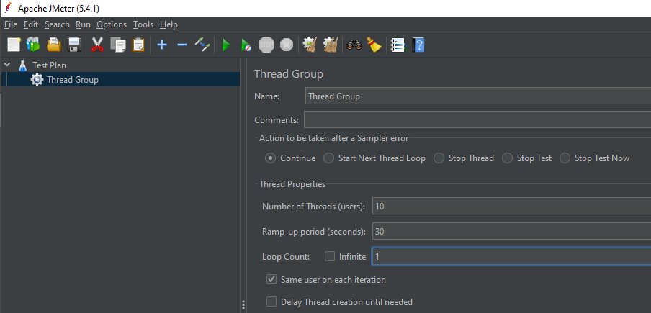
Jmeter performance Test
Notes:
I create 10 threads, which means 10 users will query the database at the same time.
I set 30 seconds as the ramp-up period, which means it will take 30 seconds for the database to finish the request. The JMeter will take 30 seconds to get all 10 threads up and running. Each thread will start 3(30/10) seconds after the previous thread was begun.
Loop Count is 1 means: 1 iteration for each user in the group using Loop Count. In this picture, JMeter will take 30 seconds to get all the 10 threads up and running.

Slide 12
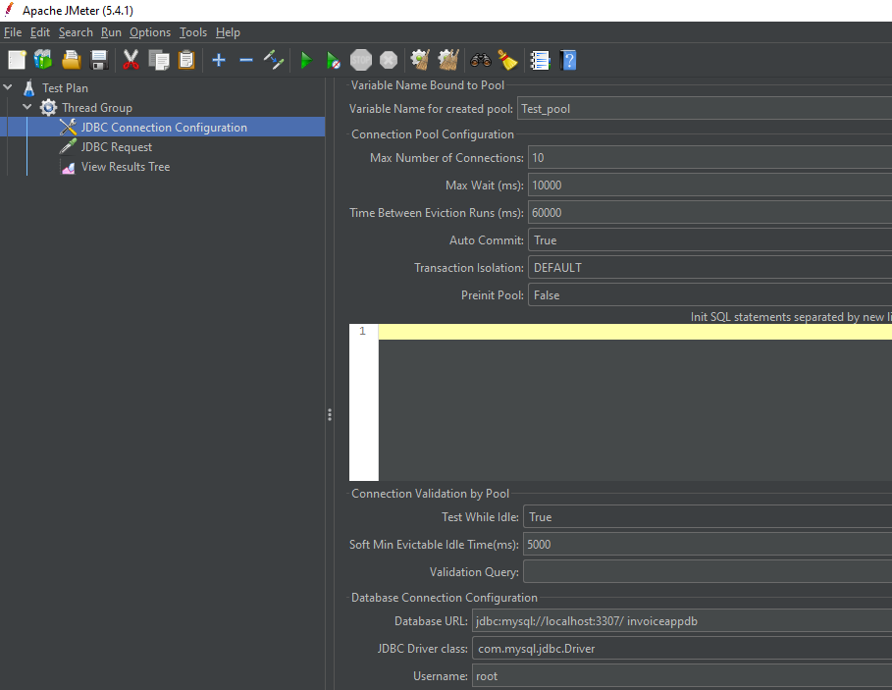
JDBC configuration
Notes:
I created a pool whose variable name is ‘ Test_pool ‘.
The max number of connections is 10.
I set the Database URL as jdbc:mysql (format) localhost:3307, I find it on mysql workbench. Invoiceappdb is my database name.
I set the JDBC Driver class as com.mysql.jdbc.Driver, which is a unique driver for Mysql
Username is root by default, I find it in mysql workbench (connect to database part)

Slide 13
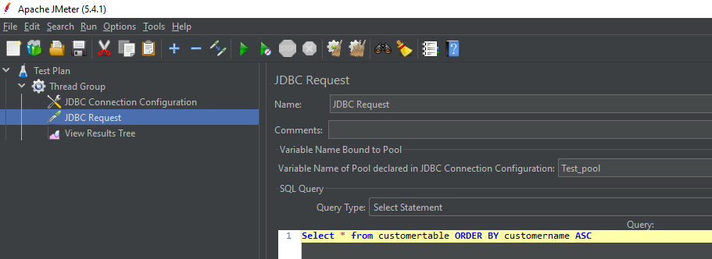
JDBC Request
Notes:
And then I fill my Pool name, which I just seted into the blanks
I select the query type as select statement.
I write a query, I want to search all the customer name in the customertable and order them by ascending order.

Slide 14
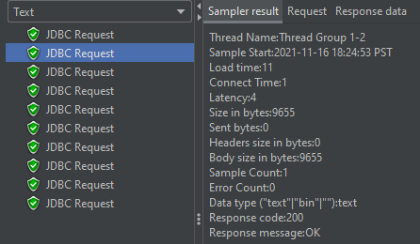
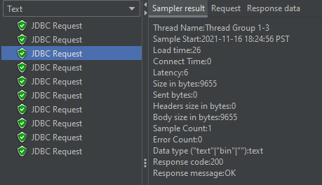
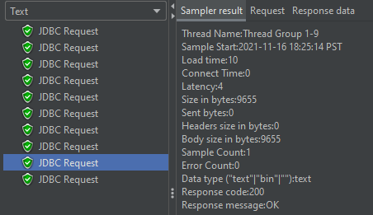
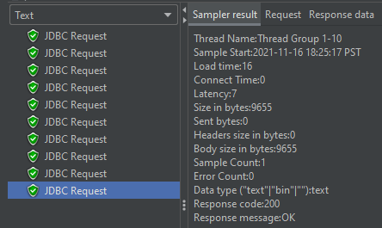
View Result Tree
Notes:
In this result, we can see the thread 2 has loading time 11, which means it takes 11 milliseconds for thread 2 to run the query. Thread 2 will use 11 milliseconds to return the result.
Connect time: In How long ( how much time) does the database connected to the Jmeter
Latency means the 2nd thread has to wait 4 seconds for the 1st thread to finish.
Response code(200) is a digital representation of response message (OK)

Slide 15
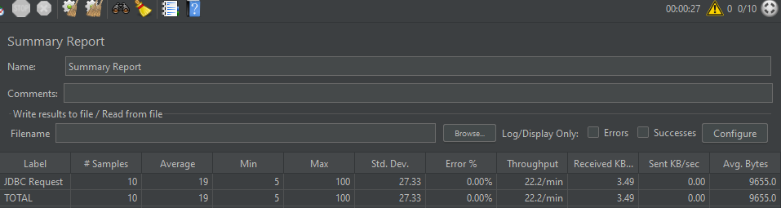
Summary Report
Notes:
In the summary report, we have 10 samples,
Average execution time of the query of these 10 users is 19 milliseconds.
Mininum execution time of the query of these 10 users takes 5 milliseconds.
Maximum execution time of the query of these 10 users takes 100 milliseconds.
Standard deviation of the execution time of the query is 27.33 mimlliseconds.
Error is 0
Throughput: number of requests / (total time) = 10 requests/ 27 seconds *60 = 22.22 requests/ min
Denominator

Slide 16
Database Performance Optimization and Comparison

Slide 17
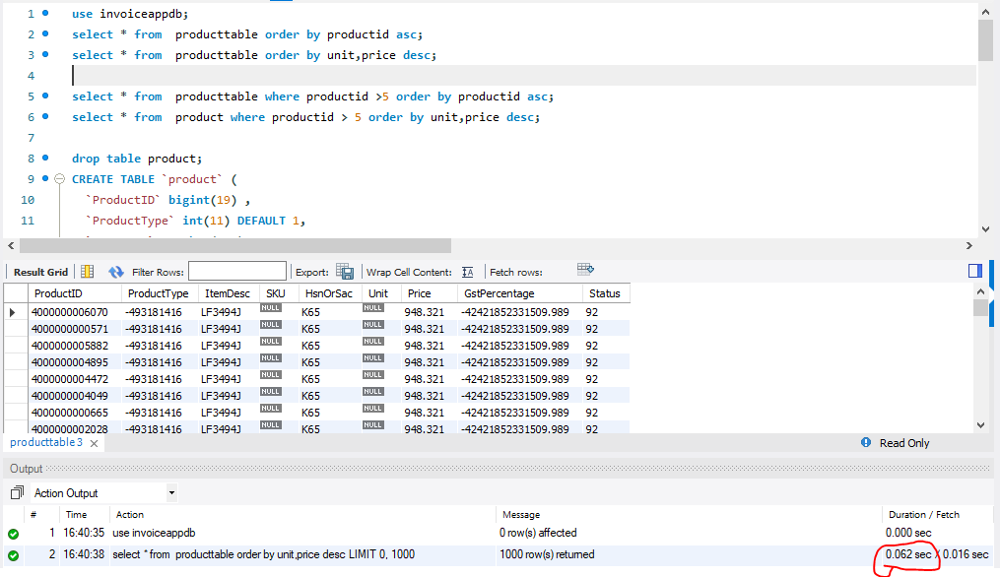
Notes:
select * from producttable order by productid asc;
This query: select * from producttable order by productid asc;
It uses 0.016 seconds to complete the task.
.(1) First, since product it is the primary key for product table, I want to select all from the producttable, sorted ascendingly by the productid, which is the key column. The duration of the query is 0.016 seconds.

Slide 18
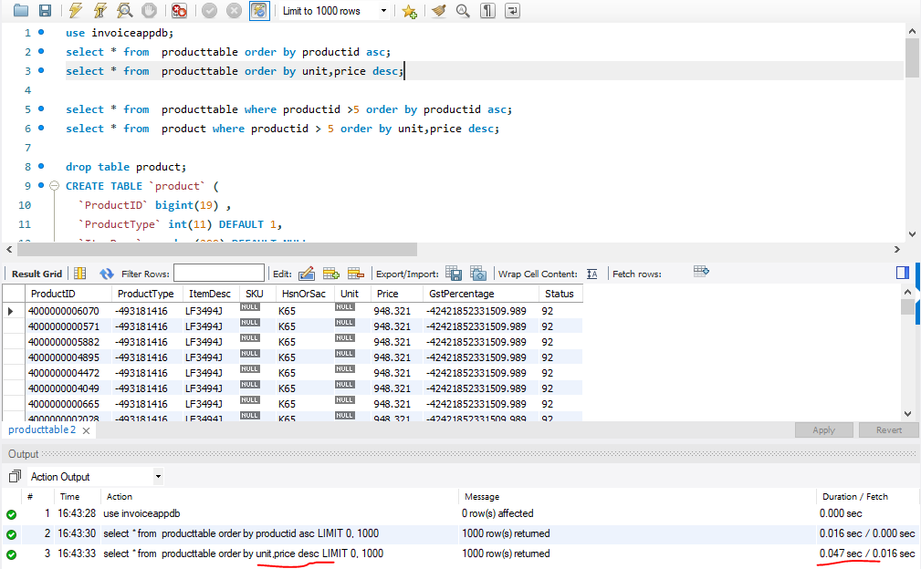
Notes:
select * from producttable order by unit,price desc;
In this query, it uses 0.047 seconds to complete the task
Comparison between key column and non-key column :(2) I select all from the producttable, sorted descendingly by the unit and price, (it orders by unit, but if some rows have the same unit, it orders them by price), which are the non-key column. The duration of the query is 0.047.
The second query is slower than the first query. Odering by the non-key column is slower than ordering by the key column.
Because key column stored the data in the sorted form. However, non-key column stored the data randomly.

Slide 19
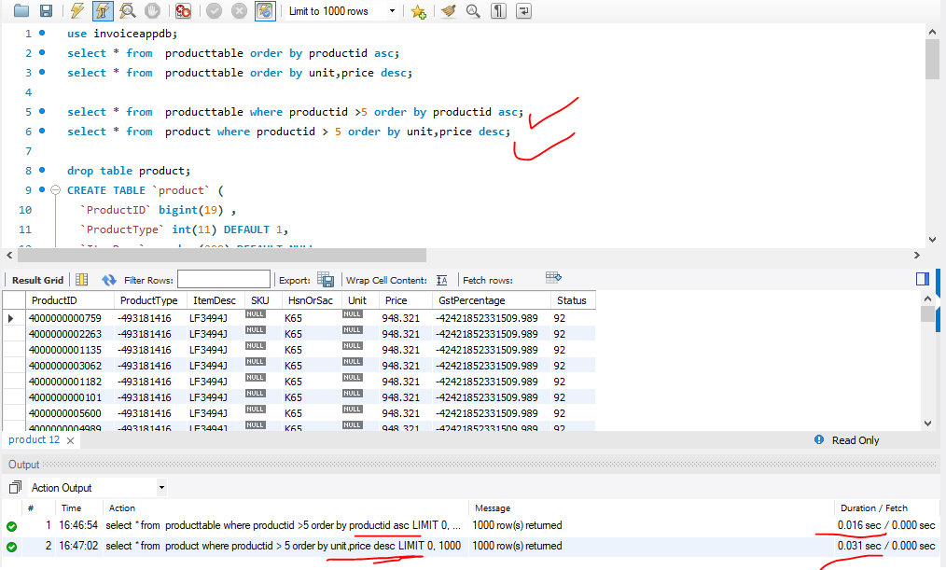
Notes:
select * from producttable where productid >5 order by productid asc; this is faster
select * from product where productid > 5 order by unit,price desc; this is slower.
Because primary key is faster than no key.
Comparison between contrain column and non-constrain column. (1) I select all from the product table where product id is greater than 5 (product id is a key column in this table), and then sorted ascendingly by its productid. This takes 0.016 seconds; (2) First, I created a ‘product’ table, which has no key column, and copy all the records from ‘producttable’ to ‘product’ table. And then I select all from the ‘product’ table, where product id is greater than 5 (product id is a non-key column), and then sorted descendingly by the unit and price. This takes 0.031 seconds. Conclusion: The contrain column is faster than the non-contrain column.

Slide 20
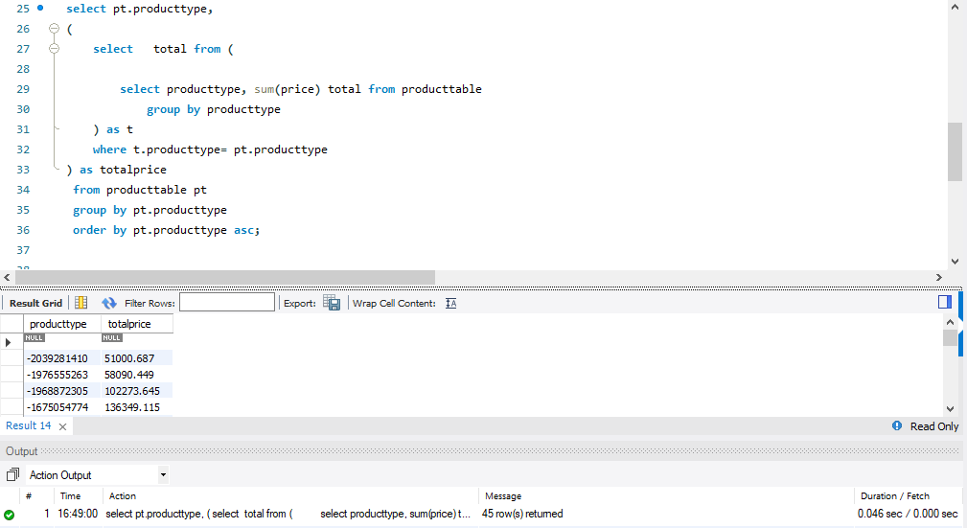
Notes:
This part takes 0.046 seconds
Comparision between nested query and inner join. (1) I use nested query, also called subquery. First I select all from producttype, which is a column name from producttable, then I calculated the sum of the prices of all products which has the same type, the column name is ‘totalprice’. Because I want to know how much I have sold for this product type. ‘Where’ means the new nested table ‘t’ will use the same product type as the producttable. And then I use group by to find all the products who are the same type. And then I order the producttype by ascending order. This query takes 0.046 seconds.

Slide 21
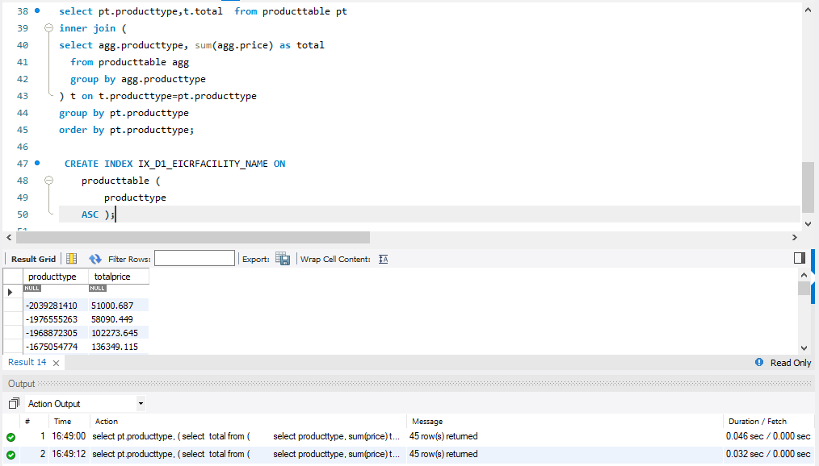
Notes:
the second part takes 0.032 seconds.
The second is faster than the first.
(2) First, I select producttype and all data (from the sumed prices table) from producttable, and then I use inner join to select records that have matching values in both producttable and sumprice table, which represented as ‘t’. And then I do the same query with the first one since I want to compare this one and the first one. I select producttype and total price from the producttable, and then I group the products which has the same type together. ‘agg’ is the alias of the product table. And then I created index on the product table, and then sort the producttype by ascending order. This query takes 0.032 seconds. The second query is optimized because it takes less time than the first query. Inner join is faster than the nested query in this example.

